Slide 1
ITCS 3134 YinHang Kwok E17 - Texture (GLCM)

Slide 2
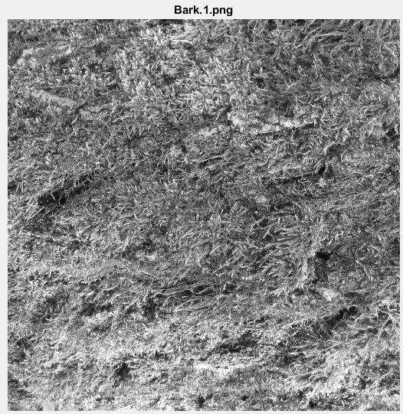
Bark.1.png

Slide 3
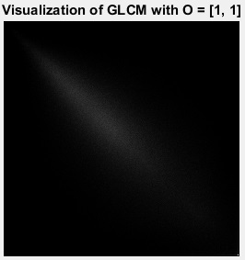
Visualization of GLCM with O = [1, 1]

Slide 4
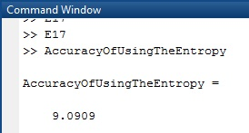
Accuracy of using the entropy

